Slide 1




Credit card fraud detection
By Argha Sarkar
Guide by Ms.Naina Devi

Slide 2






Agenda :
  Introduction
  Tools and Technologies
  Project Working (Output Screenshot)
  Applications
  Problems Faced & Solutions
  Future Scope
  Project Link
  Conclusion
  Thank You

Slide 3





Introduction to the project :
  Detect fraudulent credit card transactions using AI & ML.
  Analyze transaction patterns to classify fraud vs. legitimate.
  Improve detection accuracy through feature engineering.

Slide 4



Tools and Technologies :
  Language: Python
  Libraries: Pandas, NumPy, Scikit-learn, Matplotlib, Streamlit, Joblib
  Environment: VS Code
  Dataset Source: Kaggle

Slide 5
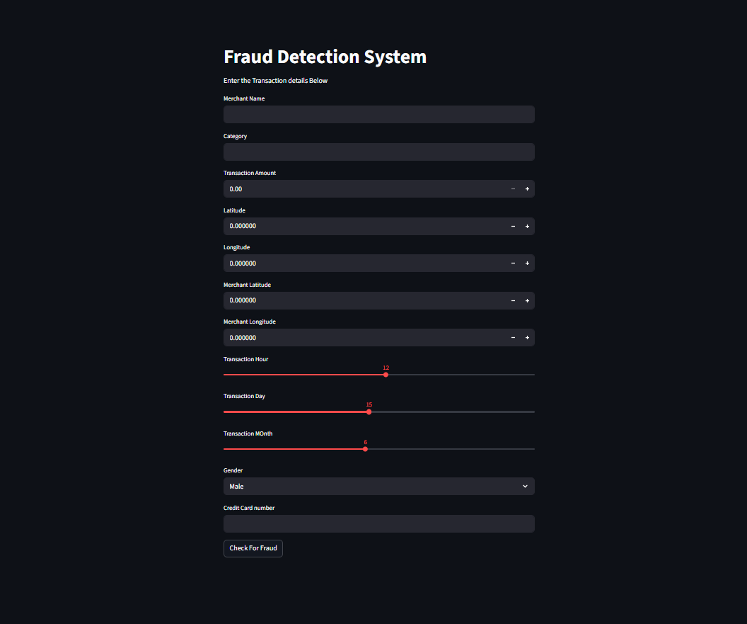
Project working :
  Model Classifies transactions as Fraudulent (1) or Legitimate (0)

Slide 6




Applications :
  Real-time fraud detection : The Streamlit app predicts whether a credit card transaction is fraudulent or legitimate instantly after entering transaction details.
  Banking and Financial Institutions : Used by banks to monitor suspicious transactions and reduce financial losses.

Slide 7



Problem faced :
Solution :
  Imbalanced data : Turned model & improved dataset .
  High false positive : Added distance & feature engineering .
  Overfitting : Used cross-validation & regularization .
  Unseen values : Handled with default encoding(-1) .
  Input variation : Added validation in Streamlit .

Slide 8




Future Scope :
  Deploy real-time fraud detection system .
  Use Deep Learning (Autoencoders,LSTM) .
  Integrate with mobile payment apps .

Slide 9





Thank You

